Slide 1
DeepDive & Analytics Systems
Lecture 19
Christopher Ré

Slide 2
Course Announcements
Lecture 19
OHs: Note that we have / are shifting these to provide better coverage before Project Part 3 & the final!
See the calendar on the website
Come to OHs early- don’t leave questions / problems till the last minute!
Piazza @1253, “Final Exam Review Session- Topic requests”
Please suggest / vote on topics for the final review session!!!
Course evaluations online- please fill these out ☺
We want your feedback to make the course even better next time!
I read every evaluation.

Slide 3
Course Announcements
Lecture 19
We received some feedback that examples used in the course might feel exclusionary to groups in the class
Not our intention!
Please keep giving us this kind of feedback.
We try very hard to consider these issues, and pick examples for lecture & assignments that are not more suited to some groups than others… but we are not always perfect
We’ll keep trying.

Slide 4
Research Lecture
Lecture 19
A taste of new applications driving research (Dark Data)
A crash course in data analytics (The Algorithm for Big Data?)
Hardware trends driving analytics systems
SHAMELESSLY BIASED BY MY GROUP’S WORK.

Slide 5
What you will learn about in this section
Lecture 19 > Section 1
Dark Data Systems & DeepDive
ACTIVITY: Ask me questions!

Slide 6

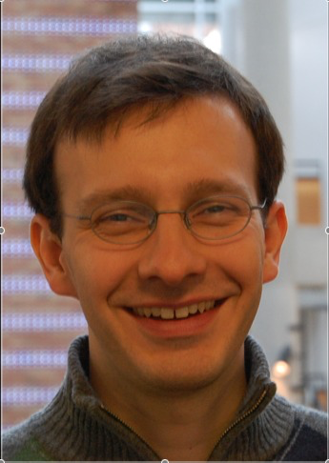

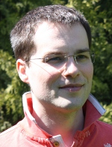
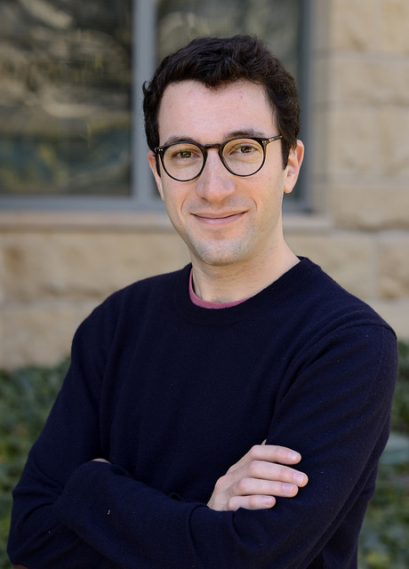
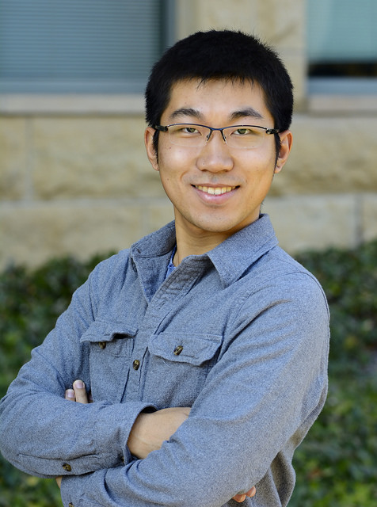

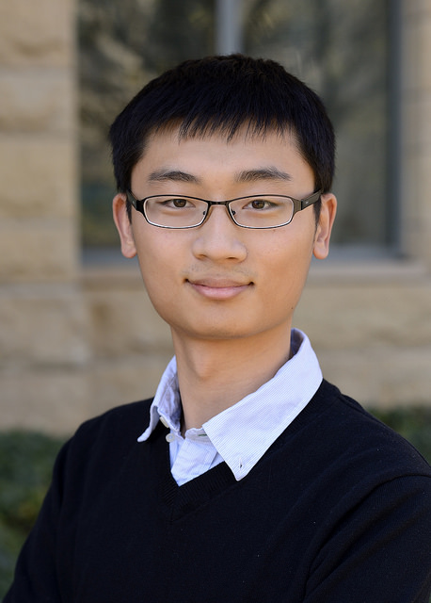
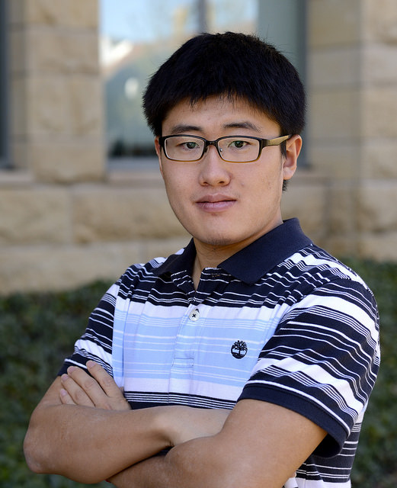
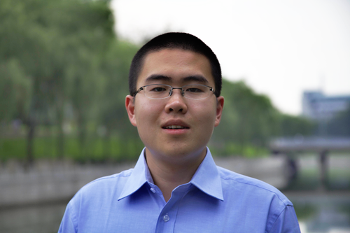
Lecture 19 > Section 1
The DeepDive Team
http://deepdive.stanford.edu/

Slide 7
Lecture 19 > Section 1
Dark Data System: ETL on Steroids
Quality that can exceed paid human annotators and volunteers

Slide 8
Lecture 19 > Section 1
Extraction, Integration, & Cleaning
are inference problems
Focus on key step for end-to-end application quality

Slide 9
Lecture 19 > Section 1
Enables non-CS users, but
scale is a challenge.
Modern hardware is changing how to build analytics systems.

Slide 10
Lecture 19 > Section 1
First, a story…

Slide 11
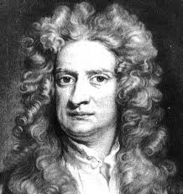
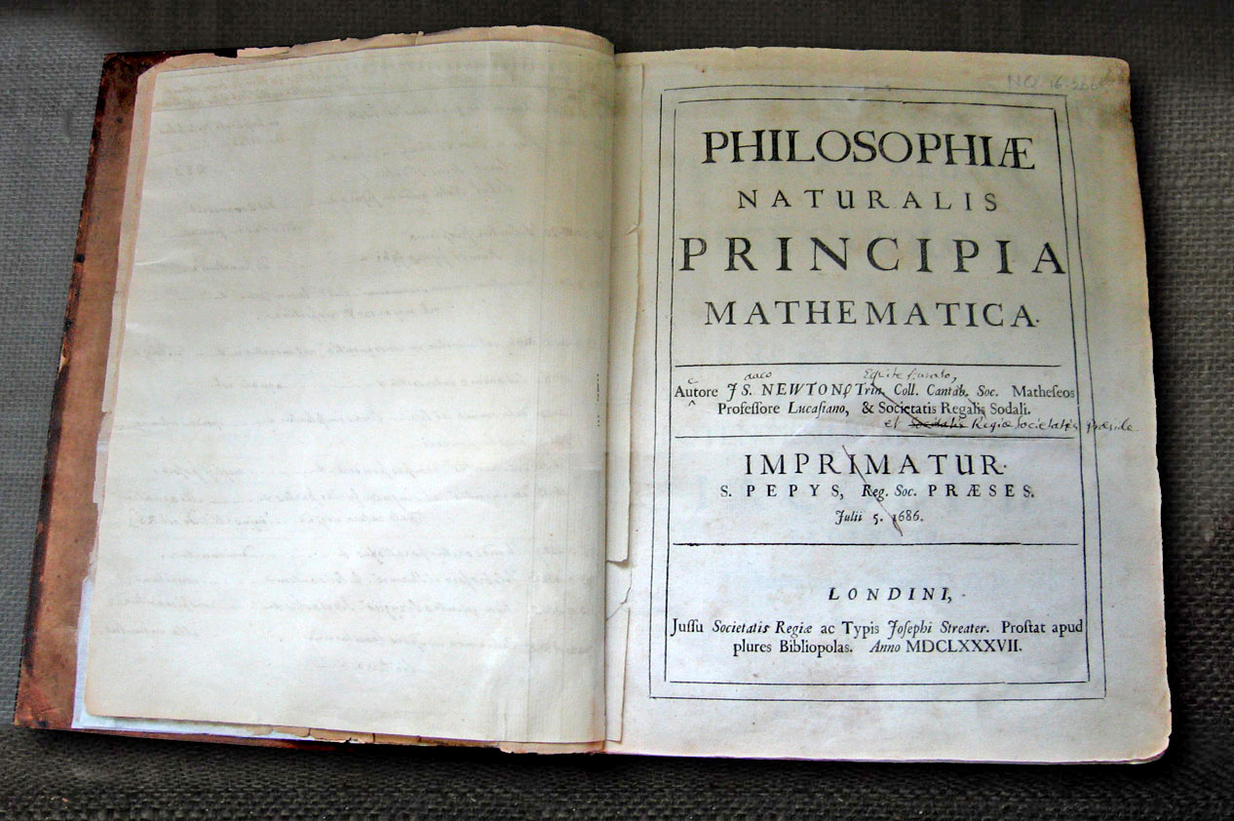
Lecture 19 > Section 1
Newton
Principia Mathematica

Slide 12
Lecture 19 > Section 1
Turns out,
Newton was not alone

Slide 13

Millennia of Knowledge in Libraries
Lecture 19 > Section 1

Slide 14
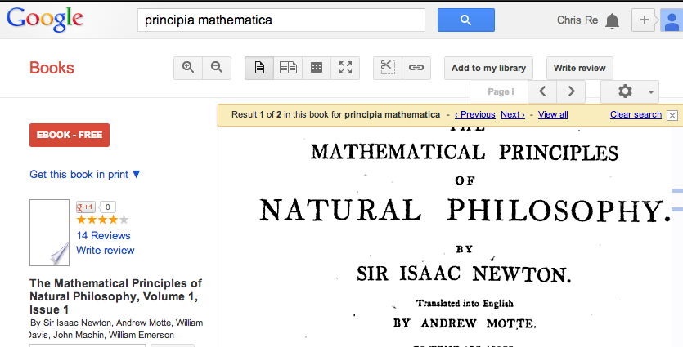
Now: freely available & digital
Lecture 19 > Section 1

Slide 15
Lecture 19 > Section 1
The world’s scientific knowledge is accessible.

Slide 16

But we’re still human …
Lecture 19 > Section 1
Notes:
http://blogs.telegraph.co.uk/culture/markmason/100054373/how-many-books-will-you-read-in-your-lifetime/

Slide 17
Lecture 19 > Section 1
The world’s scientific knowledge is accessible, but not readable.

Slide 18

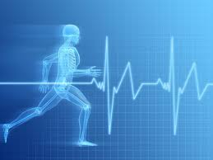

Lecture 19 > Section 1
Today, some pressing problems require
macroscopic knowledge
Climate & Biodiversity
Financial Markets
Health

Slide 19
Lecture 19 > Section 1
Could we build a machine to read for us?

Slide 20
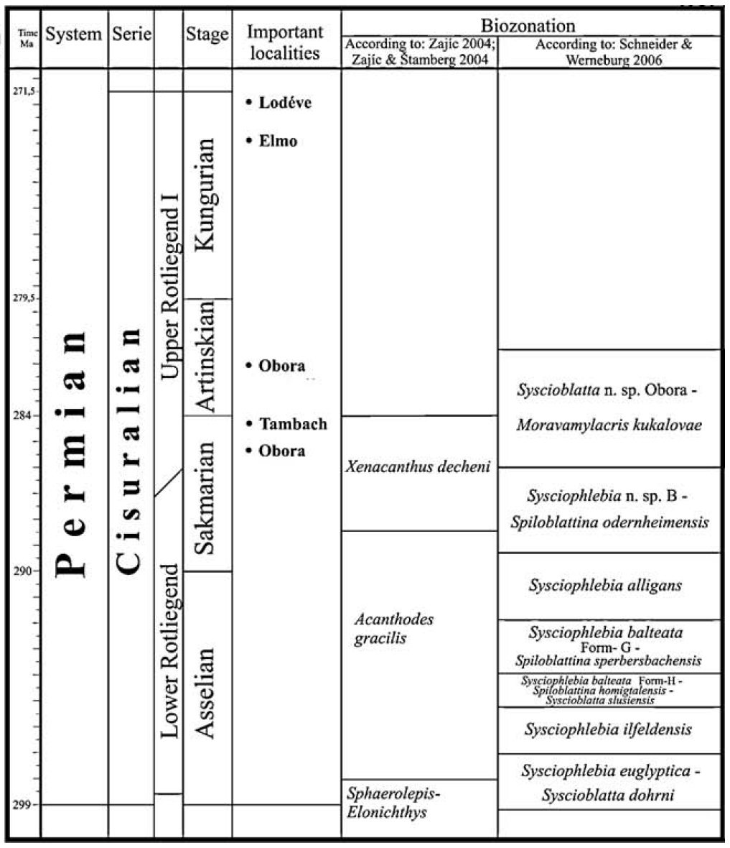
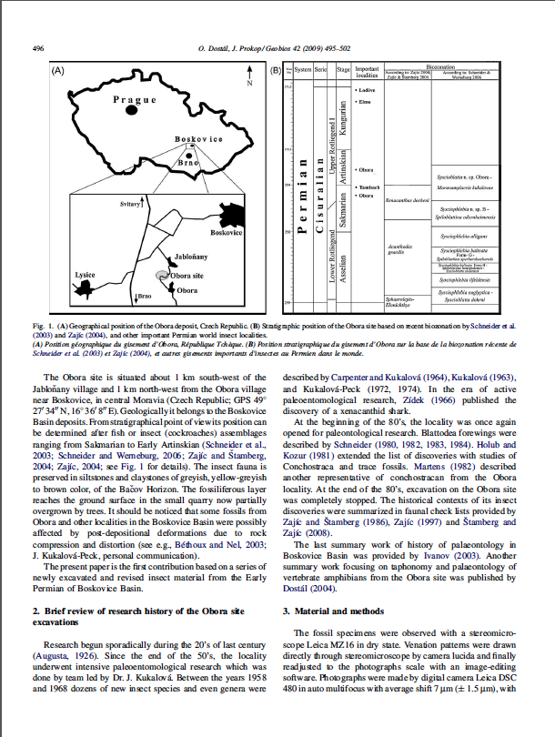
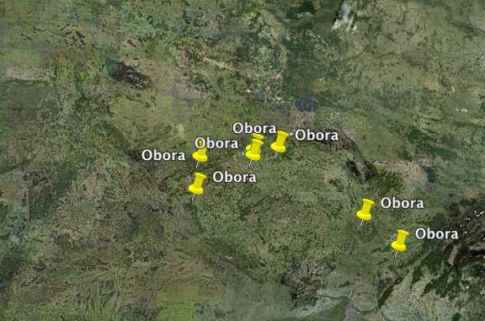
Data are buried in tables, but not in a self-contained way
Lecture 19 > Section 1
Appear
(Location,Genus)
Obora
Moravamylacris
?

Slide 21
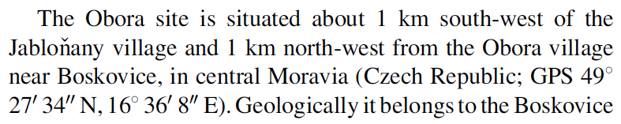
Data are buried in tables, but not in a self-contained way
Lecture 19 > Section 1
Appear
(Location,Genus)
Obora
Moravamylacris
?

Slide 22
Lecture 19 > Section 1
PaleoDeepDive
Shanan Peters (Geo) and Miron Livny (CS)
DeepDive.Stanford.edu (Ce Zhang et al.)

Slide 23
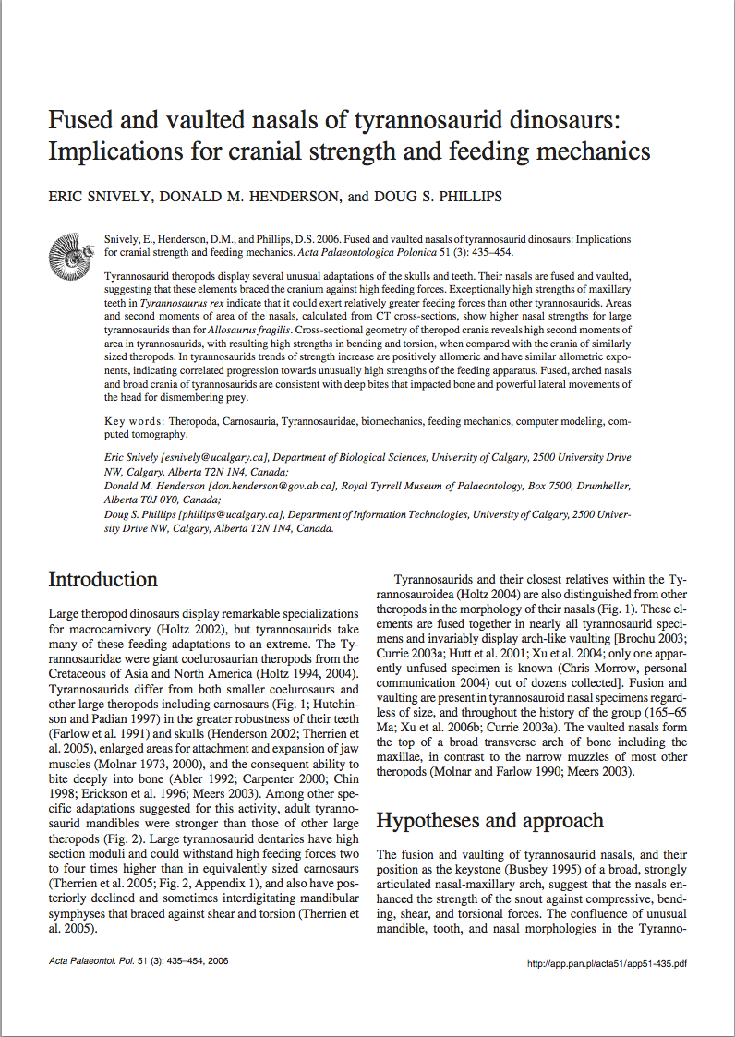
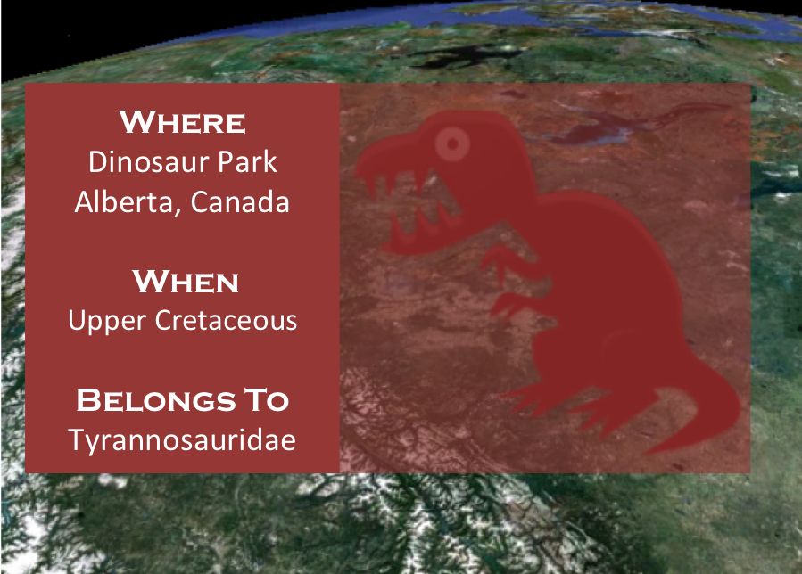
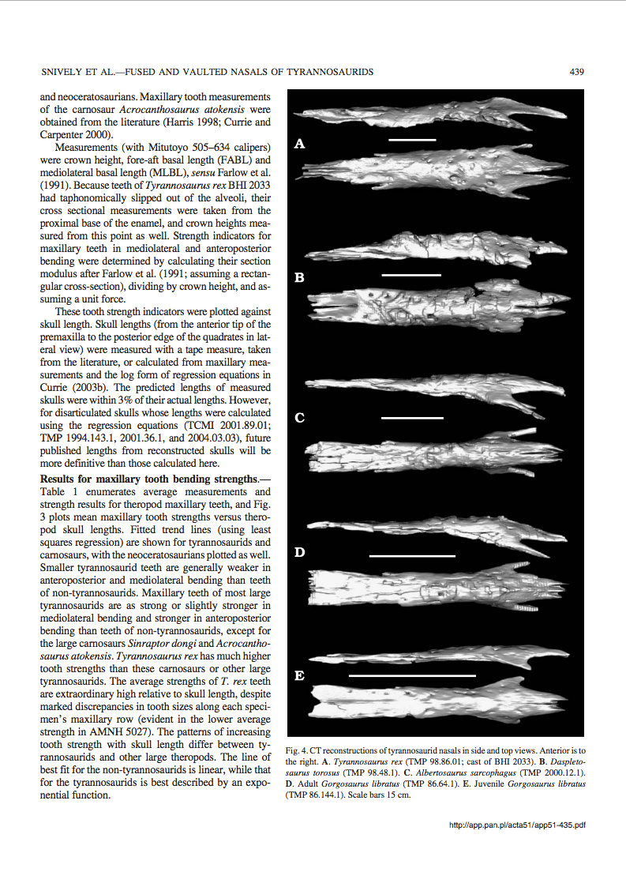
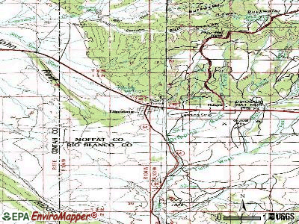
PaleoDeepDive
Lecture 19 > Section 1
The Goal
Extract paleobiological facts to build higher coverage fossil record.
T. Rex are found dating to
the upper Cretaceous.
Statistical Inference
Appears(“T. Rex”, “Cretaceous”)
Aggressive Approach
Every character, word, part of speech is a variable
statistical Inference on billions of variables.

Slide 24




Lecture 19 > Section 1
PaleoDB
PaleoDeepDive
Human-created
Machine-created
329 volunteers
10x documents.
100x extractions.
13 years
46K documents
200+ Papers,
17 Nature/Science
Preliminary Precision
Formation
Precision
PaleoDB Volunteers: 0.84
PaleoDeepDive: 0.94
Peters, S., Zhang, C, Livny, M., and Ré, C. A New Machine-Aggregated Empirical History of Life on Earth. PLOS ONE, 2014 in Nature July 15
Notes:
http://paleodb.org/bridge.pl?a=publications
# docs: 390K journal articles + 60K books (1800-2000)
# extractions:
- Entities: 6.7M
- Relations: 3.4M
# Latest quality:

Slide 25
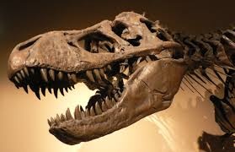

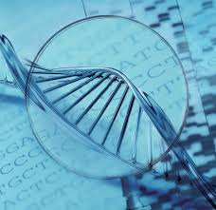
Hope: knowledge bases can help accelerate science.
Lecture 19 > Section 1
Tree of Life
Drug Repurposing
Genomics
Used by a number of companies.
and winner of TAC14 Slot Filling competitions.
Notes:
→ Hard stop.

Slide 26

Human Trafficking on the (Dark) Web…
Lecture 19 > Section 1
Hypothesis: Trafficked individuals offer
lower cost and riskier sexual services.
In Plain sight: Web ads for such services
Challenges:
Need high-resolution information to build model.
services for what rate, ethnicity, location, etc.
Scientific papers are clear—dark web is obfuscated.
Notes:
http://humantraffickingcenter.org/posts-by-htc-associates/memex-helps-find-human-trafficking-cases-online/
http://www.forbes.com/sites/thomasbrewster/2015/04/17/darpa-nasa-and-partners-show-off-memex/
The Human Trafficking Response Unit in New York County now uses Memex in every human trafficking case it pursues. According to the NYDA’s Office, Memex has contributed to over 20 active sex trafficking investigations and to nine open indictments.

Slide 27


Human Trafficking on the (Dark) Web…
Lecture 19 > Section 1
Web Text
Structured Info: Phone #, Rates of Service, …
Drug_Abuse?
Forced_Prostitution?
Use: law enforcement/ NGOs
Notes:
http://humantraffickingcenter.org/posts-by-htc-associates/memex-helps-find-human-trafficking-cases-online/
http://www.forbes.com/sites/thomasbrewster/2015/04/17/darpa-nasa-and-partners-show-off-memex/
The Human Trafficking Response Unit in New York County now uses Memex in every human trafficking case it pursues. According to the NYDA’s Office, Memex has contributed to over 20 active sex trafficking investigations and to nine open indictments.

Slide 28


In Use by Law Enforcement
Lecture 19 > Section 1
New York DA use MEMEX Data for all trafficking investigations this year. Real Arrests
For DARPA MEMEX, we were operational in 6 months
Processed >35M documents (~26M records)
Tens of columns (location, phone #, price, etc)
With compute times of less than a day
>90% Precision for most relations
Notes:
http://humantraffickingcenter.org/posts-by-htc-associates/memex-helps-find-human-trafficking-cases-online/

Slide 29
What you will learn about in this section
Lecture 19 > Section 2
A Crash Course in Analytics
ACTIVITY: Run SGD!

Slide 30
Example: Linear Models
Lecture 19 > Section 2
Label papers as DB Papers or Non-DB Papers
DB Papers
1
2
x
1. Map papers to R^{d}
Non-DB Papers
3
2. Classify via plane
5
4
How do we pick a good plane, x?

Slide 31
Example: Linear Models
Lecture 19 > Section 2
Input: Labeled papers. Each point labeled as
DB paper (+) or not (-)
x says DB Papers
+
-
x
Idea: score each plane
x says
Non-DB
-
+
-
f is convex function in x
y_{i} is a paper vector and its label
e.g. squared distance (least squares), hinge loss (svm),
log loss (logistic regression)
Notes:
Fix this

Slide 32
Separable Inverse Problems
Lecture 19 > Section 2
x | the model
y_{i} | a data item
f | scores the error
P | Enforces prior
Paper Classification: y_{i} is the paper with its label, and x is a vector of weights
Neutrinos: x is neutrino path and y_{i} is a DOM reading
Conditional Random Fields, Low-rank factorizations (relaxations), Logistic regression, Lasso, etc.
Claim: General data analysis technique that is no more difficult to compute than SQL AVG

Slide 33
Background: Gradient Methods
Lecture 19 > Section 2
Gradient Methods: Iterative
1. Start at current x^{k},
2. Take gradient at x^{k}, and
3. Move in opposite direction
F(x)

Slide 34
Background: Incremental Gradient Methods
Lecture 19 > Section 2
[Robbins & Monro, 1951]
Gradient Methods:
1. Start at current x,
2. Approximate gradient at x by selecting j in [N]
3. Move in opposite direction
Single data item to approximate gradient

Slide 35
Incremental Gradient Methods
Lecture 19 > Section 2
Why use iGMs? iGMs converge to an optimal for many problems, but the real reason is:
iGMs are fast.
Technical Connection:
iGM isomorphic to computing a SQL AVG
Solve statistical models in an RDBMS for free

Slide 36
IO Aware iGMs
Lecture 19 > Section 2
iGMs involve cheap numerical computations, but require reading / writing a lot of data…
We need to use our IO aware cost models to think about performance here!

Slide 37
Activity 19-1

Slide 38

iGMs ≈ User Defined Aggregate (UDA)
Lecture 19 > Section 2
RDBMS UDA defined by 3 Functions
Initialize (State)
Transition(State, data)
Terminate(State)
State in R² : (# terms, total)
Transition( (n, T), d ) = (n, T) + (1,d)
Terminate( (n,T) ) = T/n
AVG
State in R^{d} : model x
Transition( x, y_{j} ) = x - αG(x,y_{j})
Terminate( x ) = x
iGM

Slide 39




Widely used…
Lecture 19 > Section 2
iGM can be integrated into existing databases for free.
Significance: Reuse DB internals for shuffling, compression, shared-nothing parallelism, and shared-memory allocators.

Slide 40
What you will learn about in this section
Lecture 19 > Section 2
Trends that impact Analytics
Multicore
NUMA
SIMD

Slide 41
To get rid of algorithms, we need a fast engine….
Lecture 19 > Section 3
Modern hardware is amazing.

Slide 42
Lecture 19 > Section 3
Message
Statistical algorithms have relaxed notions of correctness; leads to new opportunities for:
Algorithms,
Systems, and
Hardware.

Slide 43

The Key Balance
Lecture 19 > Section 3
Key Issue: Balance
Statistical versus Hardware Efficiency.
Ce Zhang DimmWitted: A Study of Main-Memory Statistical Analytics. VLDB14.

Slide 44
Lecture 19 > Section 3
Modern hardware is amazing in 3 major trends for analytics:
(1) Multicore,
(2) NUMA, and
(3) SIMD.
Message: Relaxing consistency allows major performance improvements

Slide 45
Trend 1: Multicore [NIPS11]
Lecture 19 > Section 3

Slide 46
Single Cores are not getting faster.
Lecture 19 > Section 3
?
CPUDB: Danowitz et al. CACM QUEUE 2012
Speed
Chips contain multiple cores, so throughput is increasing… but need to rewrite algos!

Slide 47
Statistical Analytics Crash Course
Lecture 19 > Section 3
Staggering amount of machine learning/stats can be written as:
N (number of y_{i}s, data) typically in the billions
Ex: Classification, Recommendation, Deep Learning.
De facto iteration to solve
large-scale problems: SGD.
Select one term, j, and estimate gradient.
Billions of tiny iterations.

Slide 48
How do we run SGD in Parallel?
Lecture 19 > Section 3
Data Systems Perspective of SGD.
Insane conflicts: Billions of tiny jobs (~100 instructions), RW conflicts on x, which is called the model.
How can we hope to speed this up with parallelism? Serializability?
Multiple cores need locks to communicate!

Slide 49
How do we run SGD in Parallel?
Lecture 19 > Section 3
High-level idea: Go Hogwild! (comment out the locks!) answer is only statistically correct.
Thm: If we do no locking, SGD still converges to right answer—at essentially the same theoretical rate!
Hogwild! [Niu, Recht, Ré, Wright NIPS11]
AsySCD [Liu, Wright et al. ICML14, JMLR14]
Buckwild! [De Sa, Olukotun, Ré NIPS15]
Technical conditions on ratio of processors, delays, (semantic) sparsity.

Slide 50
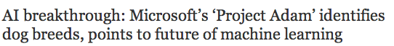

Cortana: Microsoft’s Digital Assistant
All web companies have similar: image rec, voice, mobile, search, etc.
“…using a technology called, of all things, Hogwild!”
http://www.wired.com/2014/07/microsoft-adam/
http://www.geekwire.com/2014/artificial-intelligence-breakthrough-microsofts-project-adam-identifies-dog-breeds/
Notes:
http://www.geekwire.com/2014/artificial-intelligence-breakthrough-microsofts-project-adam-identifies-dog-breeds/

Slide 51



A larger trend?
Relaxing consistency to be architecturally aware can be a big performance win.
51

Slide 52
A larger trend?
Relaxing consistency to optimize around architecture-specific IO cost models can be a big performance win.
52

Slide 53
Trend 2: NUMA [VLDB15, ICML14]
Lecture 19 > Section 3

Slide 54
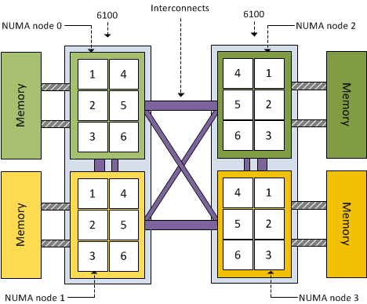
Simplified 4 socket.
Lecture 19 > Section 3

Slide 55
One Example: Quadratic Programming with Orthant Constraints.
Lecture 19 > Section 3
Parallel Sum
Spinlock
Speedup
# of Threads
Notes:
1.2 GB data set.

Slide 56
One Example.
Lecture 19 > Section 3
Parallel Sum
thrashing across sockets.
Hogwild!
Spinlock
Speedup
# of Threads
Notes:
1.2 GB data set.

Slide 57
What about multiple sockets?
Lecture 19 > Section 3
Parallel Sum
Dimm Witted
Hogwild!
Spinlock
Speedup
# of Threads

Slide 58
Model Replication
Lecture 19 > Section 3
PerMachine (Hogwild!)
Core 1
Core 3
RAM
Node 1
Node 2
RAM
Core 2
Core 4
Just Data
Model
QPI
Cache coherence
Stalls!
PerCore
Core 1
Core 3
RAM
Node 1
Node 2
RAM
Model
Core 2
Core 4
Model
QPI
Model
Model
Infrequent Communication

Slide 59
Model Replication
Lecture 19 > Section 3
Statistical Efficiency
Hardware Efficiency
In between
both Hogwild! and PerCore?
Hogwild!
High
Low
PerCore
Low
High
PerNode
Core 1
Core 3
RAM
Node 1
Node 2
RAM
Model
Core 2
Core 4
Model
QPI
Infrequent communication

Slide 60
Model Replication Results
Lecture 19 > Section 3
PerCore
PerNode
PerMachine
Time to converge
(seconds)
Better
Gibbs Sampling
SVM
Logistic Regression
No one method dominates the other.
Each can be significantly better.

Slide 61
Statistical versus Hardware Efficiency
Lecture 19 > Section 3
Relaxing consistency results in new tradeoffs.
Access methods
{Row, Column, Row-col}
Model Replication
{Core, Node, Machine}
Data Replication [SODA16]
{Full, Importance, Shard}
Can be 100x faster than classical choices, e.g., MLlib or GraphLab
DimmWitted: A Study of Main-Memory Statistical Analytics. VLDB14.

Slide 62
Trend 3: SIMD [NIPS15]
Lecture 19 > Section 3
Modern processors offer fine-grained parallelism.

Slide 63
SIMD Processing: Fine-grained parallelism
Lecture 19 > Section 3
Single instruction multiple data (SIMD)
SIMD Addition (4 way)
Standard Addition
4
1
2
3
4
R₁
R₁
4
2
4
6
8
R₂
R₂
R₁ + R₂ =
8
R₁ + R₂ =
3
6
9
12
Same operation on
multiple data points in parallel

Slide 64
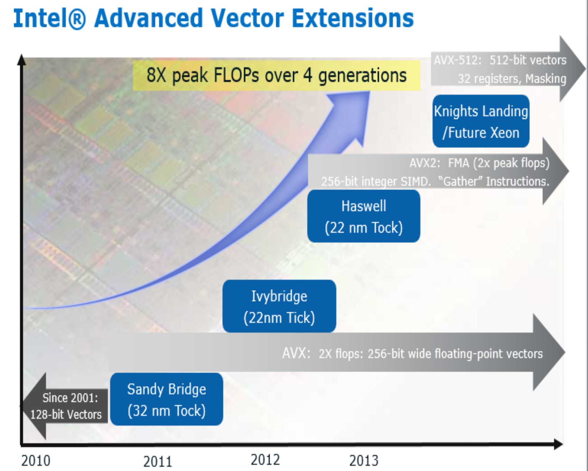
SIMD Trend: Doubling again!
Lecture 19 > Section 3
SIMD bandwidth has doubled each of the last four generations.
Image courtesy of Intel Corporation
Good old days of Moore’s Law! …
If we can take advantage of parallelism

Slide 65
Precision vs. Parallelism
Lecture 19 > Section 3
SIMD Precision
SIMD Parallelism
32-bit float vector
8 multiplies/cycle
(vmulps instruction)
F32
F32
F32
F32
F32
F32
F32
F32
16-bit int vector
16 multiplies/cycle
(vpmaddwd instruction)
8-bit int vector
32 multiplies/cycle
(vpmaddubsw instruction)
Tradeoff between precision & parallelism

Slide 66
Buckwild! [NIPS15]
Lecture 19 > Section 3
Buckwild! Is an asynchronous SGD that down-sample precision of data
Statistical theory:
Low-precision arithmetic essentially no additional error
when round-off error below the noise floor from the stochastic sampling.
Systems:
Low-precision increases effective memory bandwidth
It also decreases the load on the cache hierarchy.
Near-linear compute speedup from SIMD.

Slide 67
Statistical vs. Hardware Efficiency
Lecture 19 > Section 3
Same statistical efficiency!
Improved hardware efficiency!
8-bit gives about 2.5x speed up!
Also, we can scale up to more threads without becoming memory bound
32-bit
8-bit
Buckwild! same statistical efficiency, while greater hardware efficiency.

Slide 68
Lecture 19 > Section 3
Conclusion
Statistical Algorithms offers new opportunity
Hardware v. Statistical Efficiency.

Slide 69
Lecture 19 > Section 3
Conclusion
We can trade off statistical efficiency to focus on optimizing our IO cost (hardware efficiency)!

